Slide 1

The EEA-Eionet digitalisation framework 2030
NRC
Environmental Information Systems
Annual meeting
Webinar
21.4.2021
Stefan Jensen

Slide 2
Digitalisation
In most policies
and strategies:
Green Deal
Digital Strategy
Across partners
Across society
DIGITALISATION IS DRIVER AND ENABLER

Slide 3
EEA’s vision on digitalisation
Jointly with our Eionet and international partners, we are committed to fully exploring the potential of digitalisation in achieving sustainability transitions while reducing our environmental footprint. We co-create and disseminate the required knowledge to implement digitalisation, and will substantially strengthen our data centre functions including data intelligence.

Slide 4

Digitalisation
Innovative technologies
Big data
Sensors
Blockchain
Artificial Intelligence
Machine learning
Internet of Things
Digital Twins
DIGITALISATION IS A TOOLKIT

Slide 5

Digitalisation
Ecological footprint
Rebound effects
Digital divide
DIGITALISATION HAS
CHALLENGES

Slide 6

Digitalisation
Part of our strategy
Path to innovate and grow
Framework for activities
MAKING
EEA
EIONET
FIT FOR THE
DIGITAL AGE

Slide 7
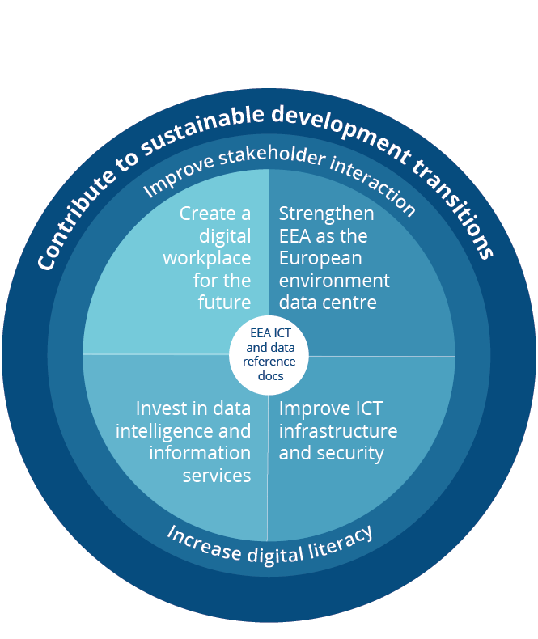
EEA-Eionet digitalisation framework 2030
10-page document – available as of April 2021
Linking EEA-Eionet strategy with
implementation activities
Identifying activity areas
Listing needed actions
Establishing a dynamic roadmap with
concrete activities

Slide 8
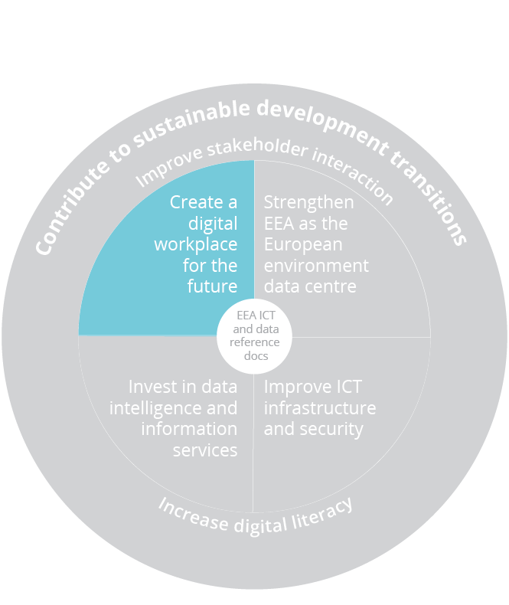
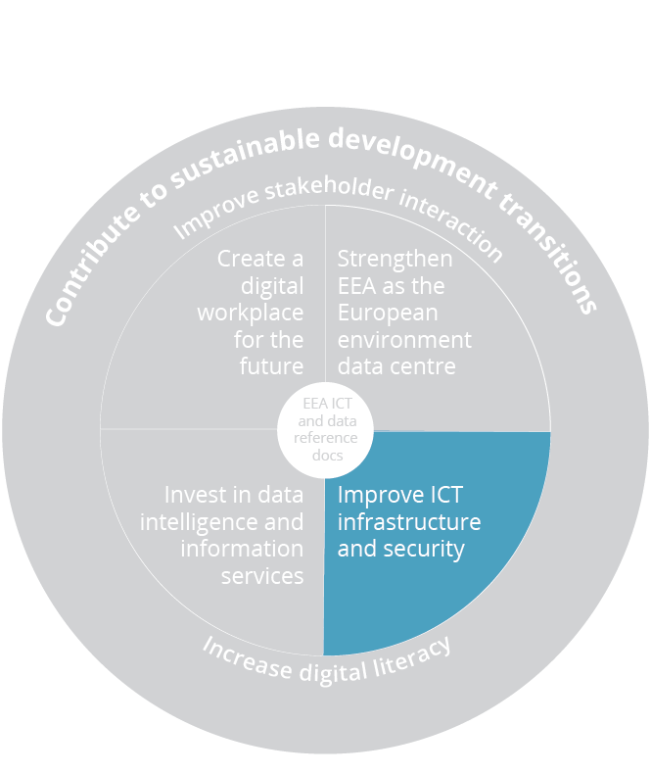
EEA-Eionet digitalisation framework 2030
Provide practical and innovative solutions
Examples:
Enable teleworking
Improve videoconferencing and other
communication tools*
Modernise workflow management
Enhance energy efficiency
Co-location of infrastructure
Enhance IT security
Security monitoring (CERT-EU)
…
* shared actions

Slide 9
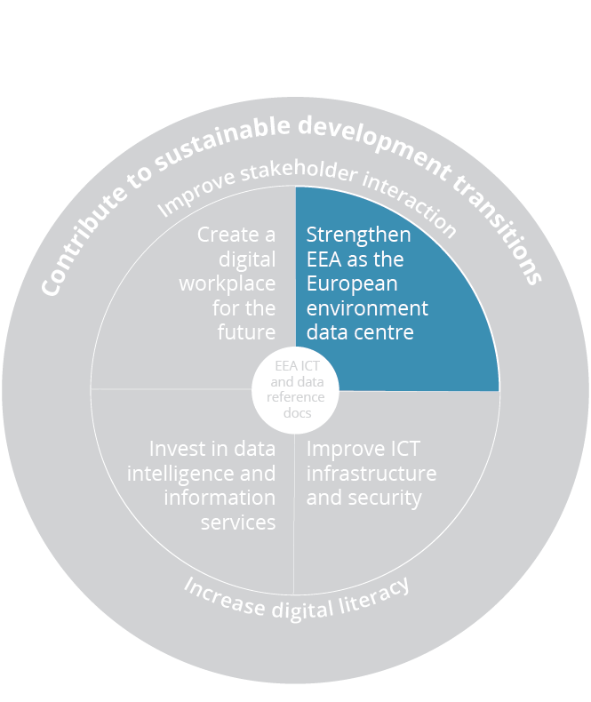
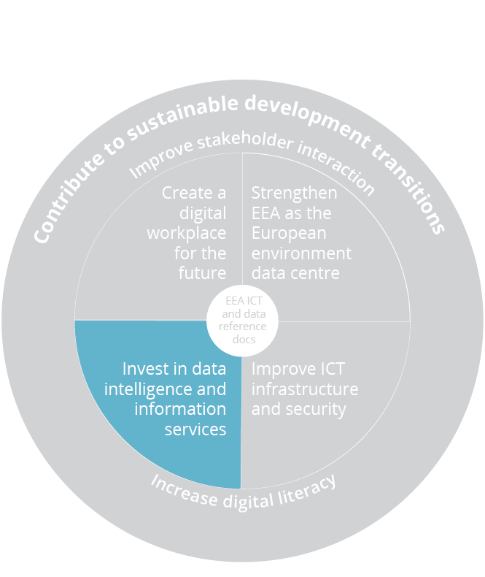
EEA-Eionet digitalisation framework 2030
Enhance data intelligence and
Information services
and
improve the data centre functions
Develop the EEA data hub
Enhance Reportnet 3.0
Use new and alternative data sources
Strengthen data analysis platform
Improve communication tools
Update data policy with FAIR and TRUST
principles
Setup AI/ML projects*
Participate in Digital Twins*
* shared actions

Slide 10
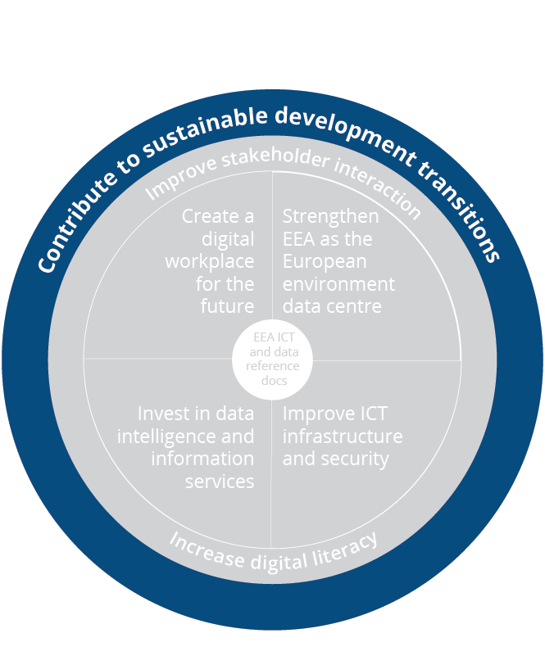
EEA-Eionet digitalisation framework 2030
Take action
Promote energy efficiency
Do green procurement
Recycle electronic waste
…
Create and share knowledge
Engage in thematic knowledge creation
projects
Innovate sustainable digital concepts
Interlink with initiatives at national and
international level*
Contribute to policy debates
…
* shared actions

Slide 11
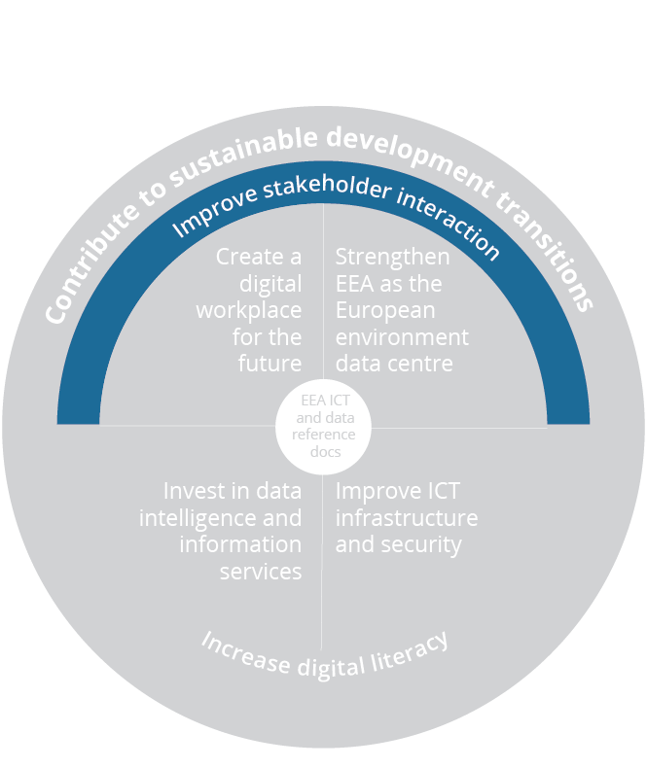
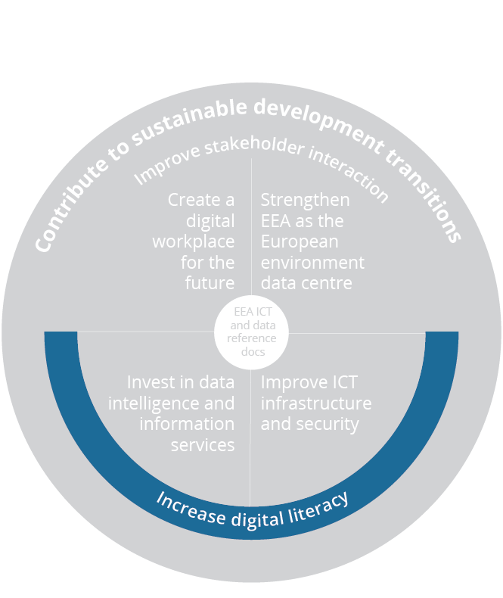
EEA-Eionet digitalisation framework 2030
Improve stakeholder interaction
Evaluate stakeholder needs, modernise tools*
Involve stakeholders in digitalisation projects*
Increase stakeholder dialogue
Support national and international processes
…
Increase digital literacy
Move to a digital mature organisation
Develop digitalisation in the EEA learning
and development framework
Inform staff and create ideas
Explore the usage of the EEAacdemy
…
* shared actions

Slide 12

EEA-Eionet digitalisation framework 2030 – areas of action
Create and share knowledge
De-carbonisation
potential in transport, energy, agriculture
Waste management
AI and sensors for habitats monitoring
ML and forward- looking methods on water
Learning and development
Digital twins:
on water cycle and climate adaptation
Initial actions on the roadmap
DIGITALISATION
IS
TRANSFORMATION

Slide 13

Starting steps with Eionet
Initially inform NRC EIS group
Goals
Respond to questions
Collect initial comments
Start a process
to collect national experiences
to explore learning and development needs
to start identifying common activities and
common activities
…
Start informing the NFP group
Common Webinar on May 4th
Similar goals
DIGITALISATION
AND
COOPERATION

